Slide 1
COVID-19 Clinical Trials – Exploratory Data Analysis

Slide 2
Objective Goal: To explore and analyze the global landscape of COVID-19 clinical trials through data. Objectives: Understand trial distribution by type, phase, location, and sponsor. Discover popular interventions. Analyze time trends and trial durations.

Slide 3
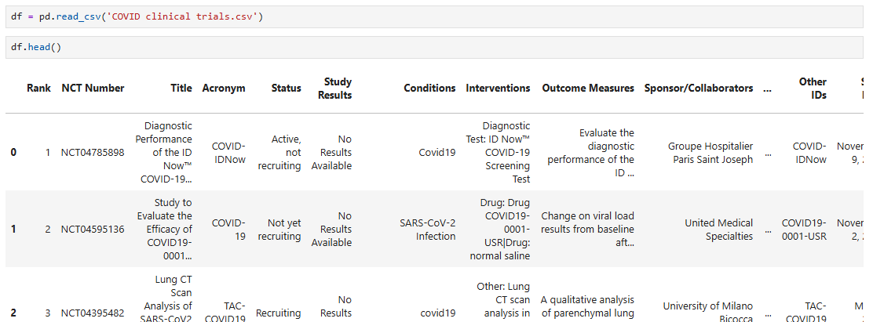
Dataset Overview
Fields include:
Study Type ,Phase ,Interventions ,Sponsor ,Enrollment ,Location , Start & Completion Dates

Slide 4
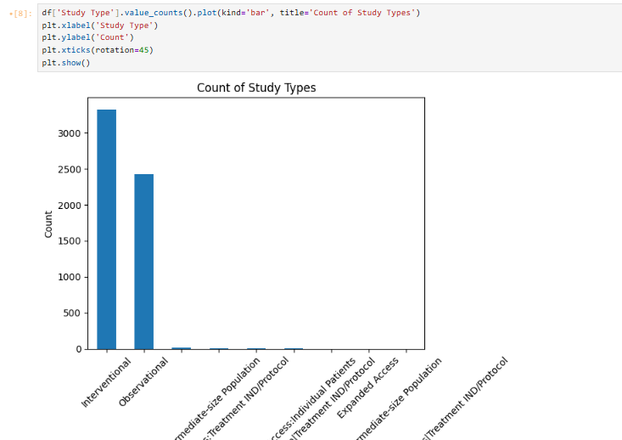
Study Type Distribution Insight: Most trials are Interventional in nature.

Slide 5
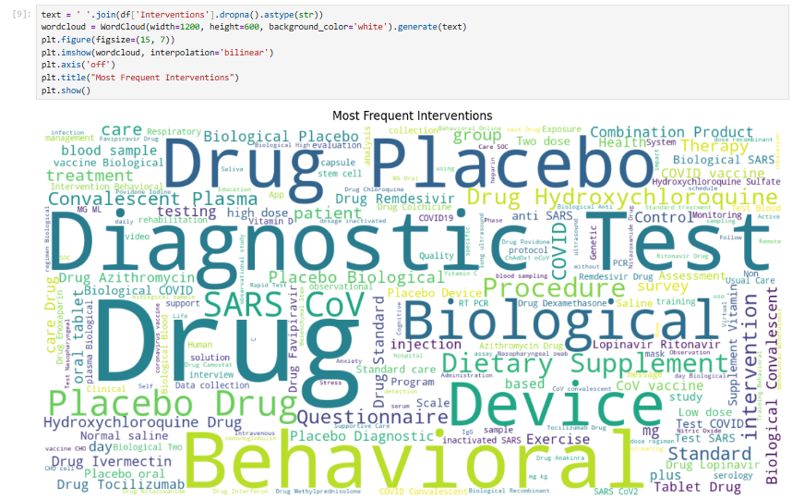
Most Common Interventions Insights: Frequent interventions include Remdesivir, Vaccine, Hydroxychloroquine, highlighting top research focus areas.

Slide 6
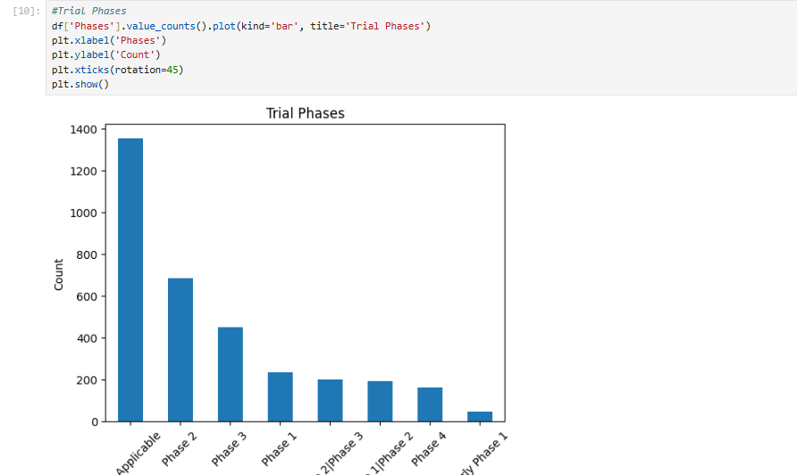
Trial Phases Insight: Most trials are in Phase 2 or Phase 3.

Slide 7
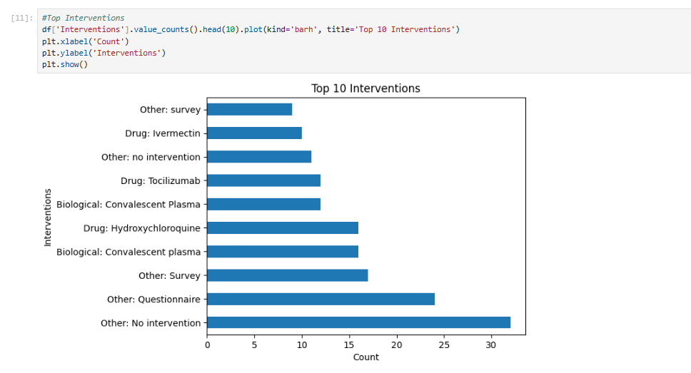
Top 10 Interventions Insight: These are the most researched drugs/interventions.

Slide 8
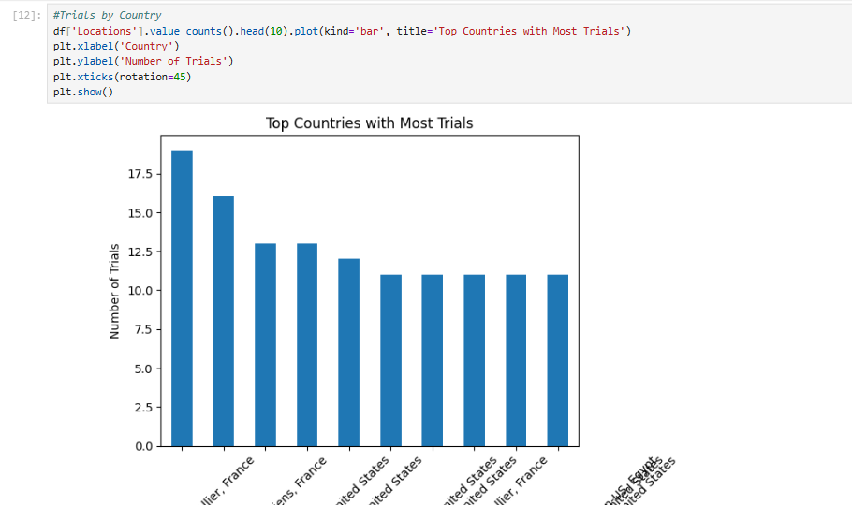
Country-wise Distribution Insight: USA and India lead in number of clinical trials.

Slide 9
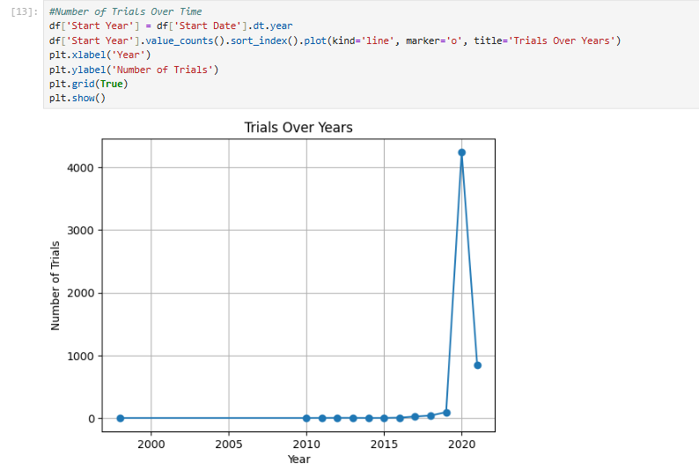
Timeline of Trials Insight: Trial activity peaked in 2020.

Slide 10
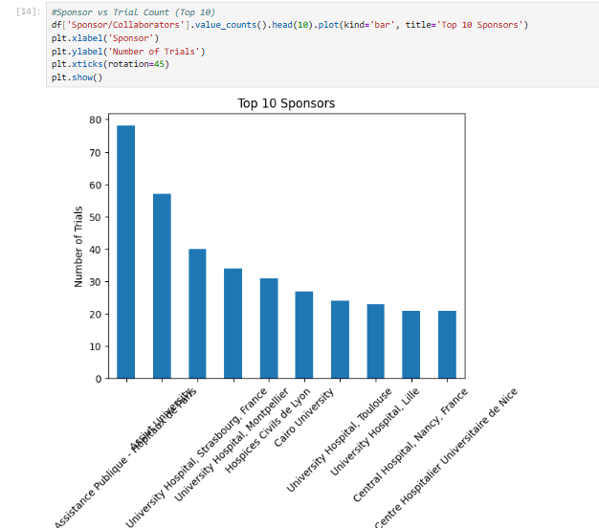
Sponsors Insight: Top 10 sponsors include universities and pharma companies.

Slide 11
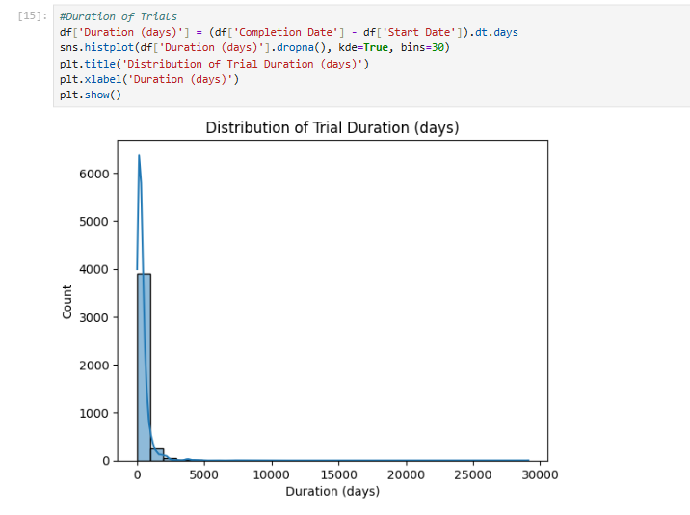
Duration Analysis Insight: Most trials lasted between 100–300 days.

Slide 12
Conclusion
Data gives valuable insight into pandemic response.
Visual EDA helps identify research patterns.
Could aid in better trial planning for future pandemics.

